Slide 1
Comparative Education
Presented by
Mehak naaz
Hafsa Safique
Submitted to Mam Saba gull

Slide 2
Education in Developed Countries
Japan

Slide 3
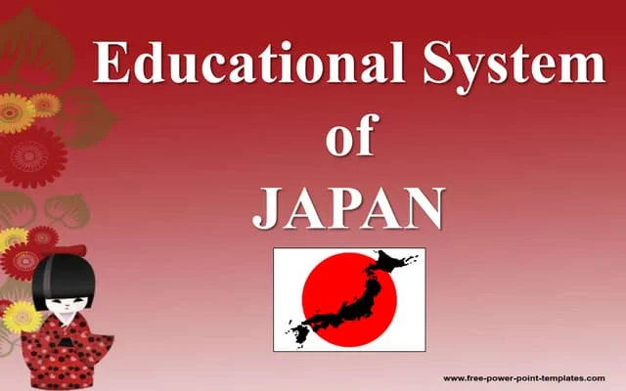

Slide 4
Introducation
Education system in Japan before and at the period of war was based on German education system characterized by high schools and university colleges purposely for educating students after completion of basic primary education (Vogel, 1971). Later on, after the occupation of Japan by the America and her allies, educational system was transformed to incorporate US educational system (Vogel, 1971)
This system constituted of three junior schools and one senior school. In the same period, a repeal of the imperial Rescript was done and the university education was formally recognized (Japan Echo, 1998). Further, the issue of Kanji was resolved and the Japanese educational system was reorganized to allow for Toyo Kanji as well as the altering of orthography to reflect the spoken usage (Vogel, 1971).

Slide 5
Brife History
Japan was founded in 660 BC.
Social sciences are very important in japenes culture.
citizens thrive on moral and poltical principles to hold up society.
Religion is aloso a major aspect in their culture , the national religion is buddhism.

Slide 6
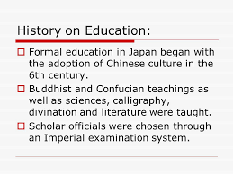

Slide 7
The educational system in japan
The japanes educational system was reformed world war 11.
The old system 6 , 5, 3, 3 years was changed to 6 ,3 ,3 ,4.
This system was implemented by the school education law enacted in Mrach 1947.

Slide 8
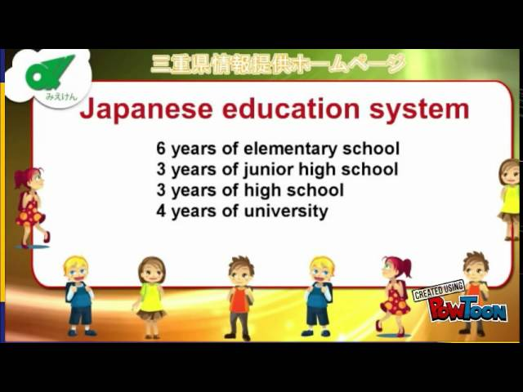

Slide 9
Mi
Ministry of Education
Curricualm , taxtbooks classes and maintains a uniform level of education throughout the country.
Education is compulsory in elementary and lower secondary levels ( junior hight school ).
Most school operate on three_term system (summer , winter , spring).
Japanese students spend 240 days a year in school , 60 days more then American counter parts (johnson).

Slide 10
Primary and secondary
Secondary Education
Secondary education includes kids age 12 to 18 . They attend school Monday througt Saturday .
Secondary education is where students beginto learn more complex material thn in primary school.
Students learn at a much slower pace than American students.
We belive it is more benifical to the students to learn in depth.
Primary Education
Primary education includes kids age 5 to 12 years,
In primary school , teachers mostly focus on creating an emotional and social connection to school and other.
Also focus strongly on creating self_confidencs and character .
Japanes school covers less topics and go in depth more than American school.
Japanes teachers try to focus on the students individual needs not the class needs.

Slide 11
COLLEGE Education
College in Japan dose not recive hight support.
Only about 2/3 of the Japan population has attented college or another trining college .
A privete university cost about 1,780,200 yen ,which university cost about 1,303,093 yen, or 11,00 American dollars.

Slide 12
The national religion in our country in this country is Buddhism .
Began in india but was adopeted from the Chines and later adopted by us 360 Million followers worldwide.
Religion

Slide 13
Transportation
Students get to school by riding bikes, trains ,or cars .
School have guidelines for students when traveling to school.
They do this so their will be a good impact on the school.

Slide 14
School begins at 8;30 A.M., but some students begin heading to school around 6;30 A.M.
Many students are required to wear uniform including a navy sailor jacket.
Students are also assigned another students to assure thire safety.
Most schools students will attend our primarily public schools.
Students cleen our school themselves.
Every Day School Routine

Slide 15
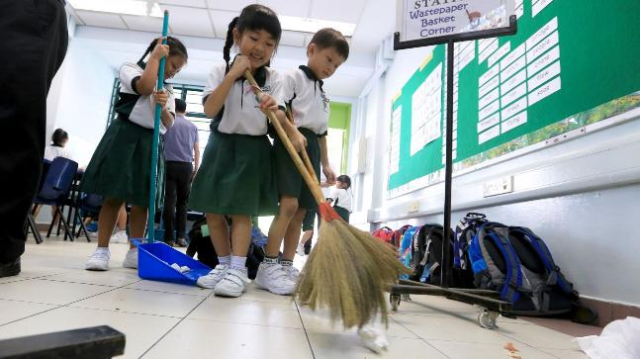

Slide 16
School culture
Japanese school system controls the individual by observing group rules.
Since preschool, children learn to maintain cooperative relationship whith thire peers, to follow the set school routines and to value relationship .
In the elementary one teacher teach all subjects in the class.
Students are taugt prpper manners ,how to speak politely , how to address adults and to relate to thitre prees in the appropriate manner.
100% p of all students complete elementary school, more then90% graduate from high school &40 graduate from college .
In higher education ,studentds took entrance exams to :first tier universities:. Each academic year has 2 semesters which starts in April.

Slide 17
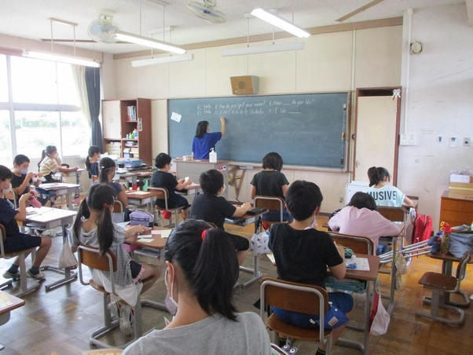

Slide 18
THANK YOU HAVE A PLEASANT DAY EVERYONE! GODBLESS….

